Slide 1
Instructions
This slide/poster size is 40.97” x 23.04” (16:9 aspect ratio)
Minimum font: 28pt (this may seem large, but at this poster size it’s not)
Recommended font types: Calibri, Arial, Times New Roman
When you are creating your e-poster, please make sure to save your formulas as an image and embed it into your presentation or they will change on our Surface Tablets.
Any video files need to be in .mov, .mpeg, .m4v or .mpg format
All files need to be saved in PPTX format
Bring the final version of your eposter and any video files to the event on a flash drive as a backup.

Slide 2
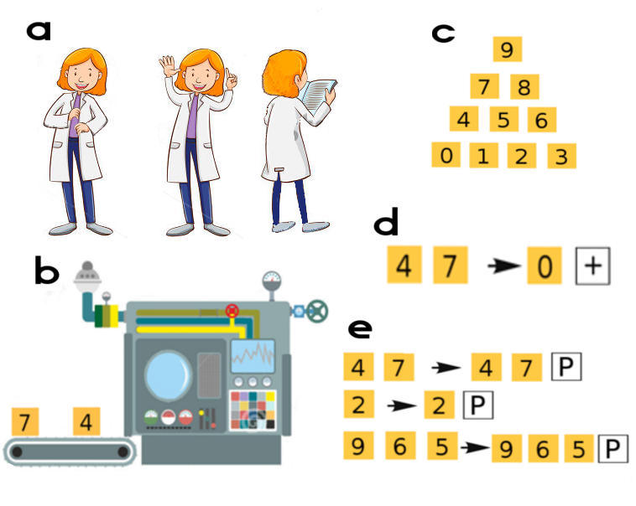
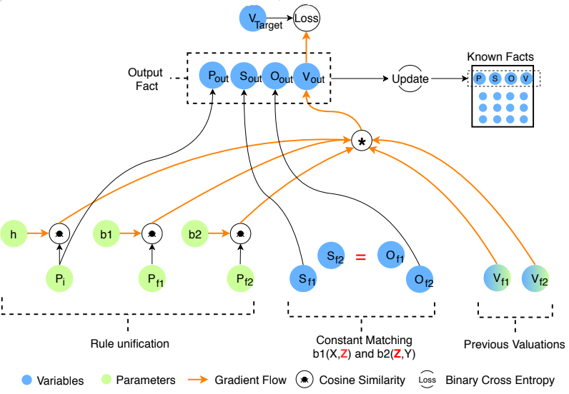
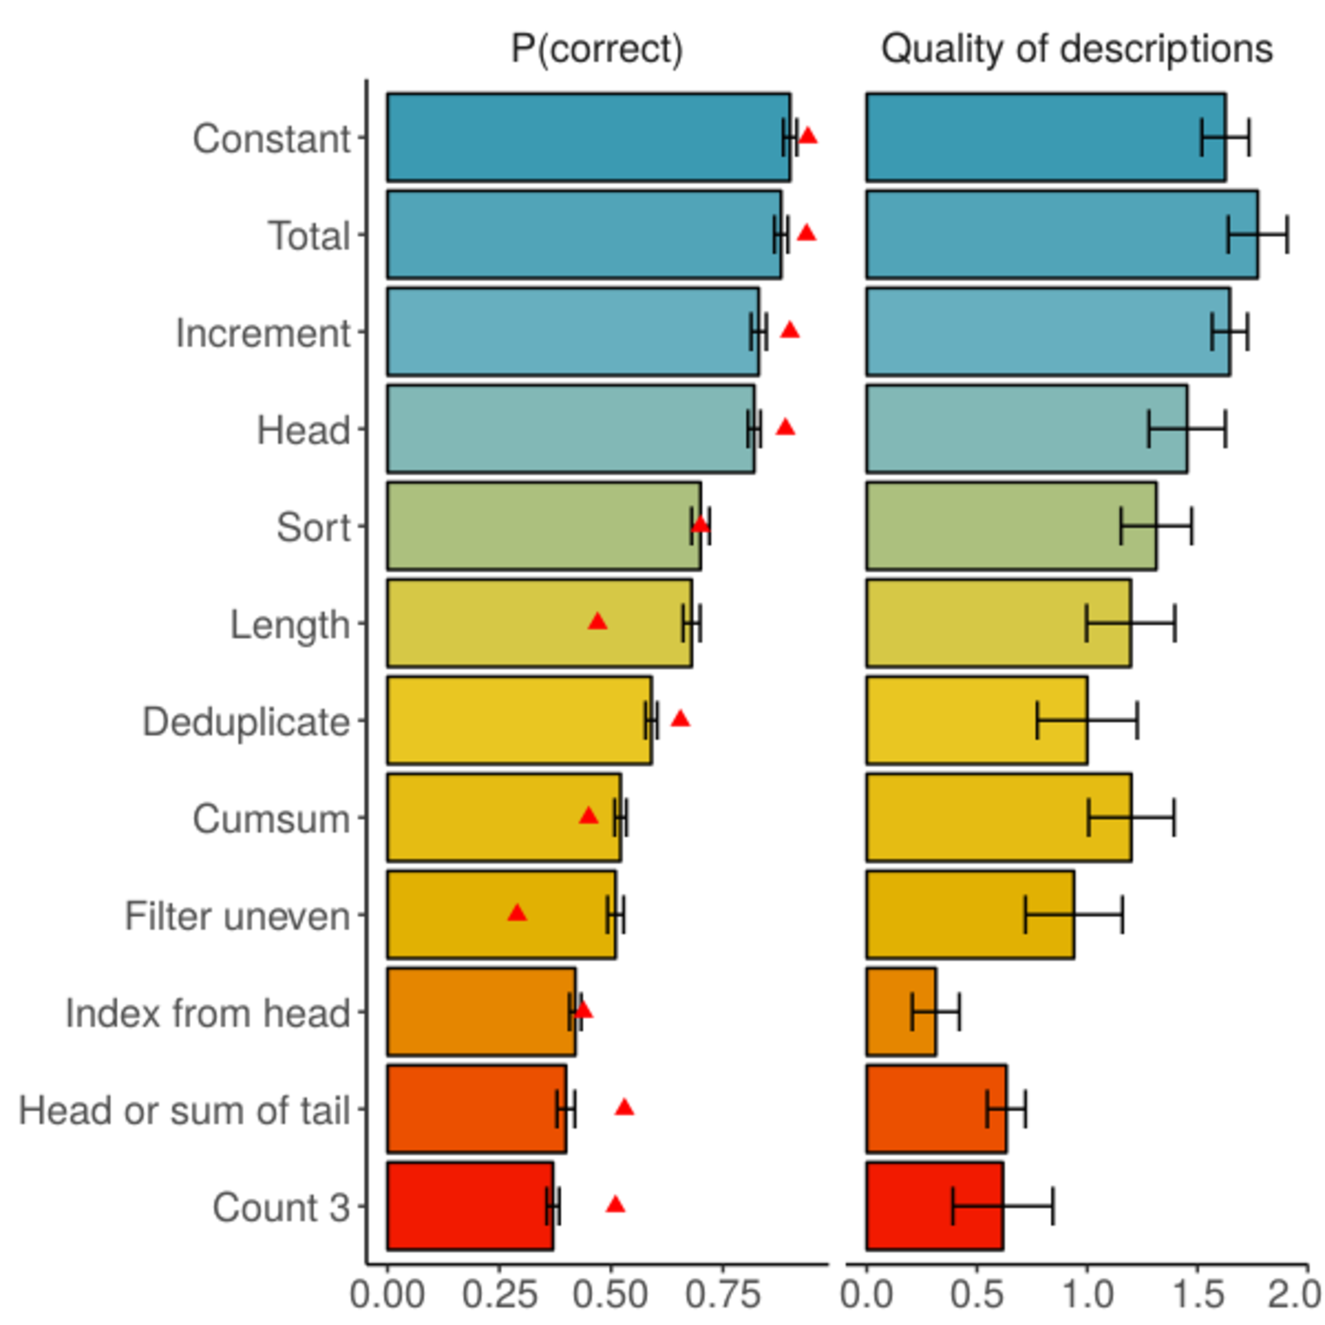
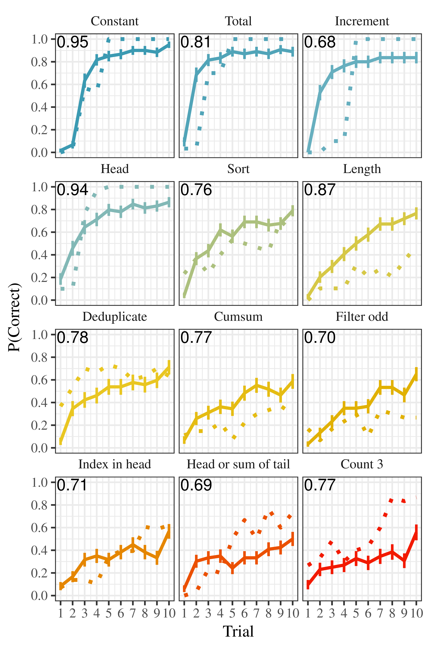
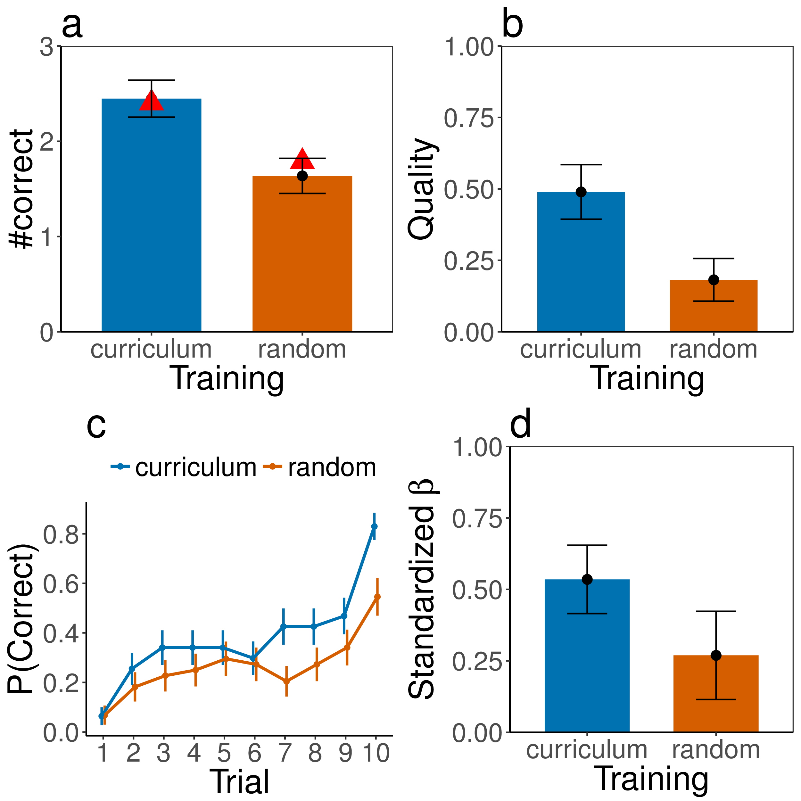
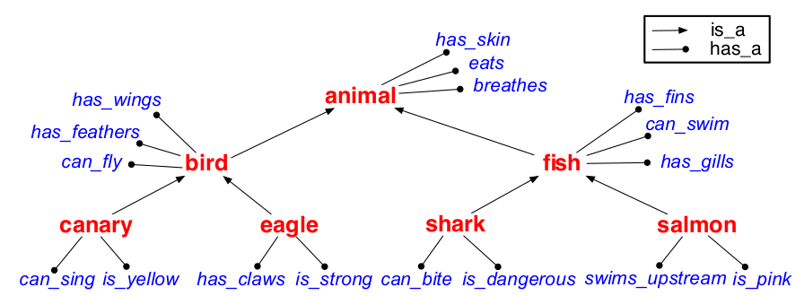
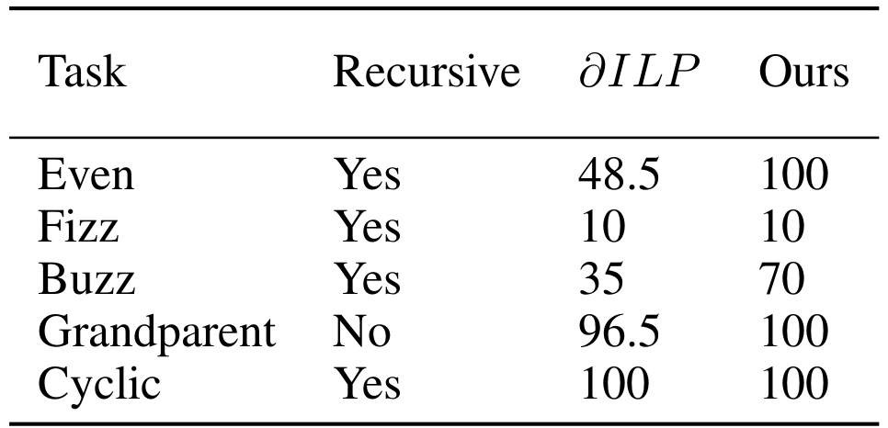
Computational Cognitive Science Group,
Dept. of Brain and Cognitive Sciences
Concept Learning as Program Learning
Joshua S. Rule, Andrés Campero,
Maxwell Nye, Joshua B. Tenenbaum
Learning List Concepts through Program Induction
Stuff from Max Nye
Logical Rule Induction via Neural Theorem Proving
Problem: model human learning of structured concepts in two online experiments using a game-based
paradigm (left) for a family of twelve
list transformation .concepts (right).
Problem: transform a knowledge base of observations (left) into a logical theory containing generalized predicates and core facts (right).
[grandfatherOf, ABE, BART].
[fatherOf, ABE, HOMER].
[fatherOf, HOMER, BART].
[parentOf, ABE, HOMER].
[parentOf, HOMER, BART].
[fatherOf, JAMES, HARRY].
[parentOf, LILY, HARRY].
...
[grandfatherOf, X, Y] :-
[[fatherOf, X, Z], [parentOf, Z, Y]].
[parentOf, X, Y] :- [fatherOf, X, Y].
[parentOf, X, Y] :- [motherOf, X, Y].
[fatherOf, ABE, HOMER].
[fatherOf, HOMER, BART].
[motherOf, LILY, HARRY].
...
Approach: neuro-symbolic program induction
Approach: learn rewrite rules (left) building on assumed primitives (right).
the larger of head or summed tail
Results: Exp. 1: model predicts overall (left) and per-trial performance; (right). Exp. 2: curriculum training outperforms random training for (a) overall performance, (b) description quality, (c) trial-by-trial performance, and (d) predictive power of past performance.
Results: This approach recovers taxonomic relations (left) as well as out-perform previous state-of-the-art on a variety of problems (right; score is percentage of random initializations leading to solution. 𝛿ILP is previous state-of-the-art (Evans, Grefenstette, 2018)).

